Slide 1

SnapShot
A Simple Photobooth Website
🔗 GitHub: https://github.com/DEVA-013/Snapshot
PRESENTED BY
Devadharshini D
Gurrala Nikhila
Marripati Thanuja

Slide 2
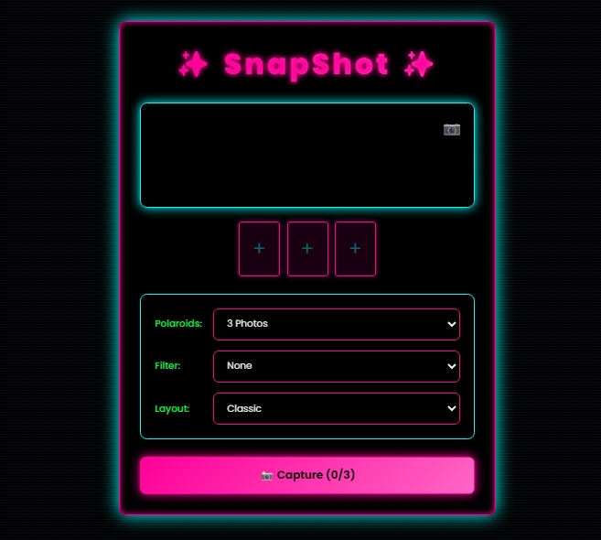
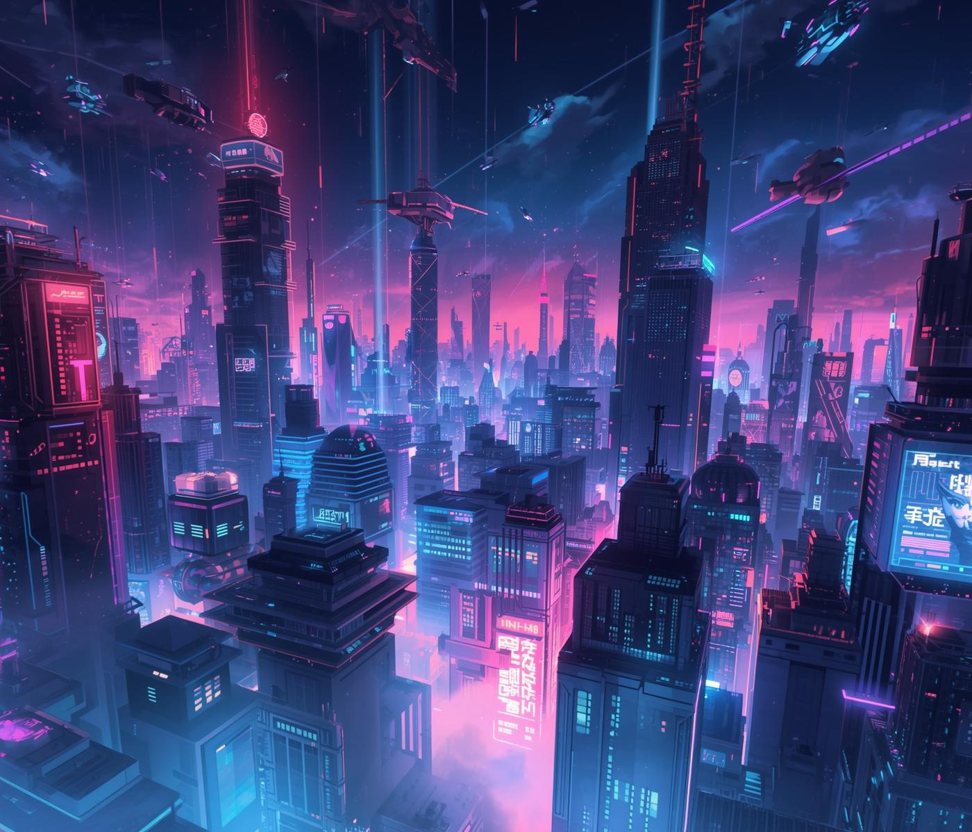
What is Snapshot?

Slide 3
A browser-based photobooth application
Users can take photos using their webcam
Developed with web technologies(HTML, CSS, JS)

Slide 4
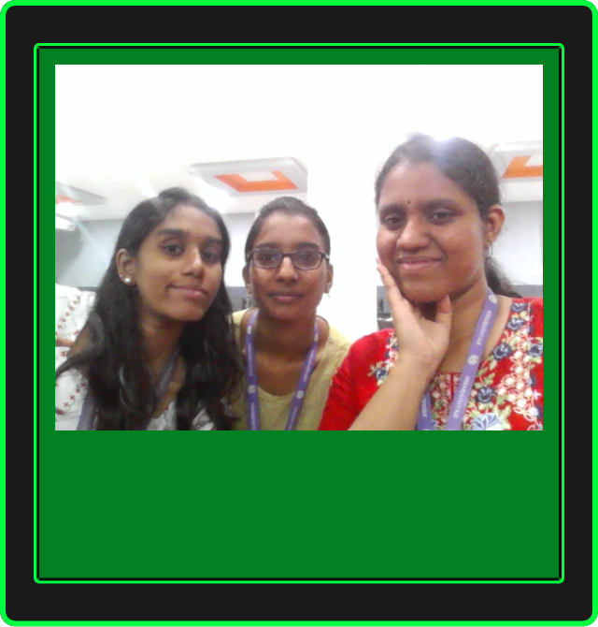
Neon - Retro Tech
A FUSION OF RETRO AND MODERN THEME
PRIMARY ACCENT COLORS
DESIGN CHARACTERISTICS
Neon Cyan
Neon Purple
Electric Pink
Neon Green
Bold Visuals
Minimalist Layouts
Glowing Titles

Slide 5

Pixel Borders in Neon Retro Tech
MAINTAINING MINIMALISM WITH PIXEL BORDERS

Slide 6
Working of SnapShot
Browser requests webcam permission
Live video feed displayed
JavaScript captures the image on clicks
Photo preview/download shown

Slide 7
Technology Stack
HTML: Layout & UI elements
CSS: Styling and responsiveness
JavaScript: Webcam access & snapshot logic

Slide 8
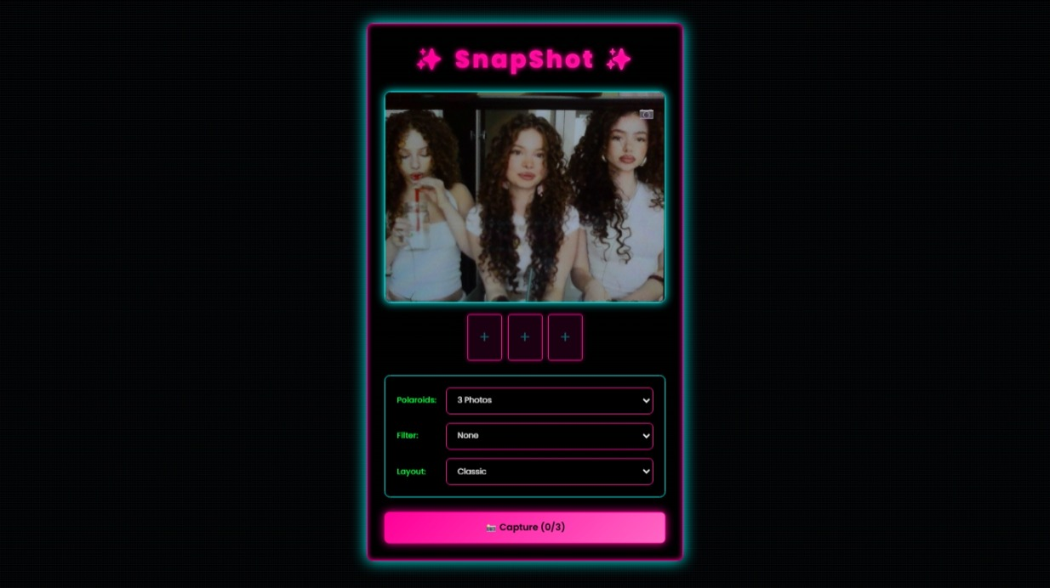
Demo

Slide 9
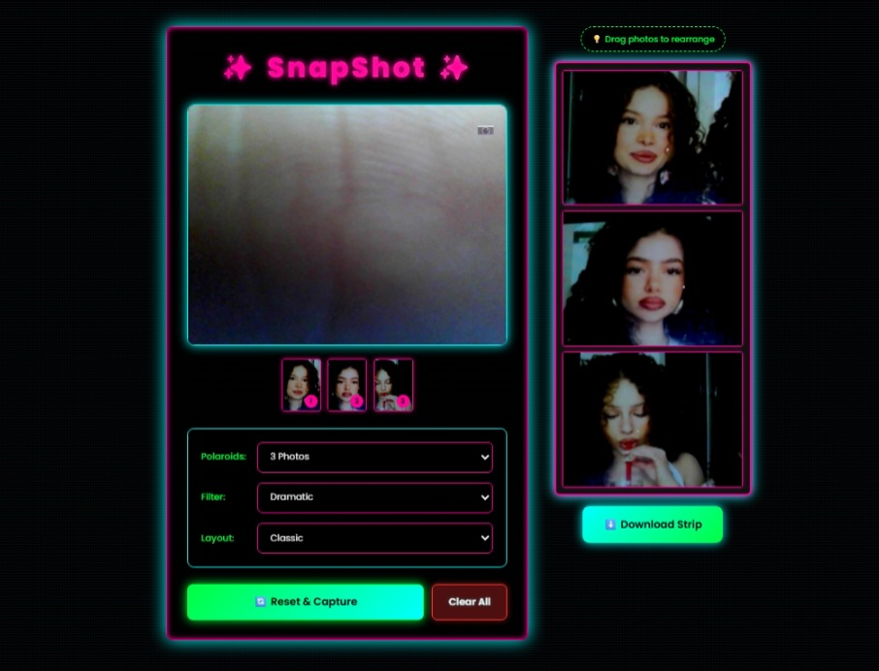
Process Flow

Slide 10
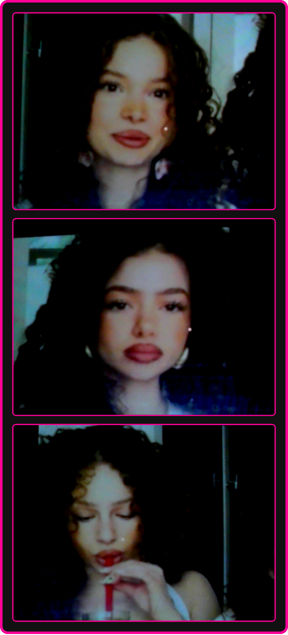
Downloaded Picture Strip

Slide 11

Thank You!

